Slide 1

Dr. Rakhee Chhibber
Probability

Slide 2
Introduction
Probability is a measure of the likelihood of an event to occur. Many events canno
For example, when we toss a coin, either we get Head OR Tail, only two possible outcomes are possible (H, T). But when two coins are tossed then there will be four possible outcomes,
i.e {(H, H), (H, T), (T, H), (T, T)}

Slide 3
Formula for Probability
The probability formula is defined as the possibility of an event to happen is equal to the ratio of the number of favourable outcomes and the total number of outcomes.

Slide 4
Question 1
1) There are 6 pillows in a bed, 3 are red, 2 are yellow and 1 is blue. What is the probability of picking a yellow pillow?
Ans: The probability is equal to the number of yellow pillows in the bed divided by the total number of pillows, i.e. 2/6 = 1/3.

Slide 5
Question 2
2) There is a container full of coloured bottles, red, blue, green and orange. Some of the bottles are picked out and displaced. Sumit did this 1000 times and got the following results:
No. of blue bottles picked out: 300
No. of red bottles: 200
No. of green bottles: 450
No. of orange bottles: 50

Slide 6
a) What is the probability that Sumit will pick a green bottle?
Ans: For every 1000 bottles picked out, 450 are green.
Therefore, P(green) = 450/1000 = 0.45

Slide 7
b) If there are 100 bottles in the container, how many of them are likely to be green?
Ans: The experiment implies that 450 out of 1000 bottles are green.
Therefore, out of 100 bottles, 45 are green.

Slide 8

Question
What is the probability of drawing a heart from a deck of cards?
Answer - there are total 52 cards in a deck out of which 13 cards are of heart.
So the favourable outcomes are 13 and the total no. of events is 52.
= 13/52 = 1/4

Slide 9

If we toss two coins together, then what is the probability of getting at least one tail?
The favorable outcomes for at least one head will be
{HH}, {HT}, {TH} = 3
P (for at least one head) = 3/4

Slide 10
Tossing 3 Coin Probability
Sample space
S = {(H, H, H), (H, H, T), (H, T, H), (H, T, T), (T, T, H), (T, T, T), (T, H, H), (T, H, T)}
Find the probability of getting exactly two heads when we toss three coins
Answer - The required case in two coin toss is,
A = {(H, H, T), (H, T, H), (T, H, H)}
=> n(A) = 3
Total sample space “S” = {(H, H, H), (H, H, T), (H, T, H), (H, T, T), (T, T, H), (T, T, T), (T, H, H), (T, H, T)}
=> n(s) = 8
Probability of getting exactly two heads = P(A) = (Favourable Case)/(Total Case)
P(A) = 3/8
Thus, the probability of getting two heads in three coin toss is 3/8.

Slide 11
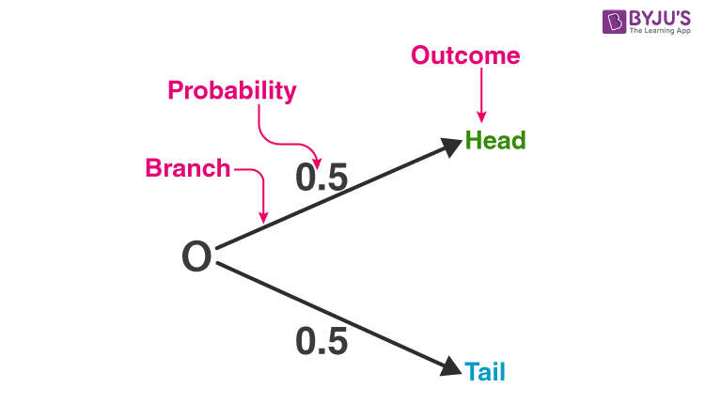
Probability Tree

Slide 12
Types of Probability
Dr. Rakhee Chhibber

Slide 13
2 types
Experimental Probability
Theoretical Probability

Slide 14
Experimental Probability
Experimental probability is the probability, which tells the possible outcomes, after performing an experiment. For example, if you toss a coin 50 times, then we could have different outcomes, in repeating experiments i.e. for experiment 1, the number of heads = 23, and the number of tails = 27, for experiment 2, the number of heads = 26, and a number of tails = 24, and so on… Here, if we find the probability of getting a head, it will be nearer to 0.5, but not exactly will be equal to 0.5. Formula
Probabitlity = number of required outcomes after performing an experiment / total number of times experiment performed

Slide 15
Theoretical Probability
Theoretical probability, tells how likely an event is going to occur, and in these events, we will only be assuming what can be the possible outcomes, but will not be performing experiments. For example, as we have seen above in the coin example, the experimental probability of getting a head/tail is near 0.5, but not exactly equal to 0.5, but theoretical probability, says that the probability of getting a head/tail is equal to 0.5, as head and tail are equally likely outcomes. Theoretical probability is also called classical probability. Formula
P(E) = Number of trials in which an event occured/ total number of trials

Slide 16
Events and Outcomes
Before moving on to probability, we need to understand what are events and outcomes. An outcome is the result of an experiment, and this experiment is called an event that has possible outcomes. For example, choosing an Ace from a deck of 52 cards, is an event, with outcomes, diamond Ace, spade Ace, club Ace, and heart Ace. Now, we have different types of events and outcomes.

Slide 17
Types of Events
There are 5 different types of events i.e.
sure events,
impossible events,
normal events,
complementary events, and
elementary events.

Slide 18
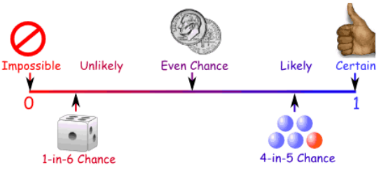

Slide 19
Sure Events
A sure event is an event that will always occur, irrespective of the other factors. For example, the probability of getting a number between 1 and 6, is 1. Hence, the probability of a sure event is always equal to 1.
P(Sure Event) = 1

Slide 20
Impossible Events
An impossible event is an event that can never happen. For example, the probability of getting a number greater than 6, is 0. Hence, the probability of an impossible event is always equal to 0.
P(Impossible Event) = 0

Slide 21
Normal Events
A normal event is an event, that can have any probability, i.e. between 0 and 1 inclusive. A sure event and an impossible event, are also normal events. For example, the probability of getting 1 on a die is 1/6.
0 <= P(E) <= 1

Slide 22

Complementary Events
A complementary event is an event, such that the sum of the probability of occurring an event and the probability of not occurring an event is equal to 1. For example, the probability of getting a number less than 3 on a die is, 2/6, and then the probability of not getting a number less than 3 is 4/6. Hence, the sum of their probabilities is equal to 1.

Slide 23

Elementary Events
An elementary event is an event, which has only one outcome. For example, the probability of getting the number 2 on a die is, 1/6, similarly, the probability of getting the number 1 on a die is 1/6, and similar for all the rest numbers….. The sum of probabilities of all elementary events is equal to 1.

Slide 24
Types of Outcomes
There are two different types of outcomes i.e. equal likely outcome, and non-equally likely outcome.
Equally likely outcome
An equally likely outcome is the outcome that has, the same output and probability. For example, tossing a coin will give an equally likely outcome, i.e. head or tail, hence the probability of each of them is 1/2, rolling a die, will give an equally likely outcome i.e. 1, 2, 3, 4, 5, 6, hence the probability of each of them is 1/6.
Non-Equally likely outcome
A non-equally likely outcome is an outcome, that has uncertainty in its outcomes and also depends on the various other factors. For example, starting a car, and the car starts or does not start, this gives a non-equally likely outcome, because the car will always start unless it needs maintenance/service.

Slide 25
Cards Probability
The 52 playing cards in a deck are separated into four suits of hearts, diamonds, clubs, and spades.
Specific symbols are used to represent the four suits:
Hearts: A red heart symbol (♥) represents the heart suit.
Diamonds: A red diamond symbol (♦) represents the diamond suit.
Clubs: A black club symbol (♣) represents the club suit.
Spades: A black spade symbol (♠) represents the spade suit.
Ace, 2, 3, 4, 5, 6, 7, 8, 9, 10, Jack, Queen, and King are the 13 cards that make up each suit.

Slide 26
Card probability
If we draw a card from a properly shuffled deck, it may happen in one of several ways:
Drawing a specific card: In this case, a specific card, such as the Ace of Spades or the Queen of Hearts, is drawn from the deck. (P = 1/52)
Drawing a card from a certain suit: In this scenario, a card from a particular suit, such as a heart or a diamond, is drawn. (P = 1/13)
Drawing a card of a particular rank: The emphasis of this event is on drawing a card of a particular rank, such as a King or a 7. (P = 1/13)
Drawing a face card: In this case, the King, Queen, and Jack of each suit are included in the face card. (P = 3/13)
Drawing a red or black card: This event refers to drawing a card that is either red (hearts or diamonds) or black (clubs or spades). (P = 1/2)

Slide 27
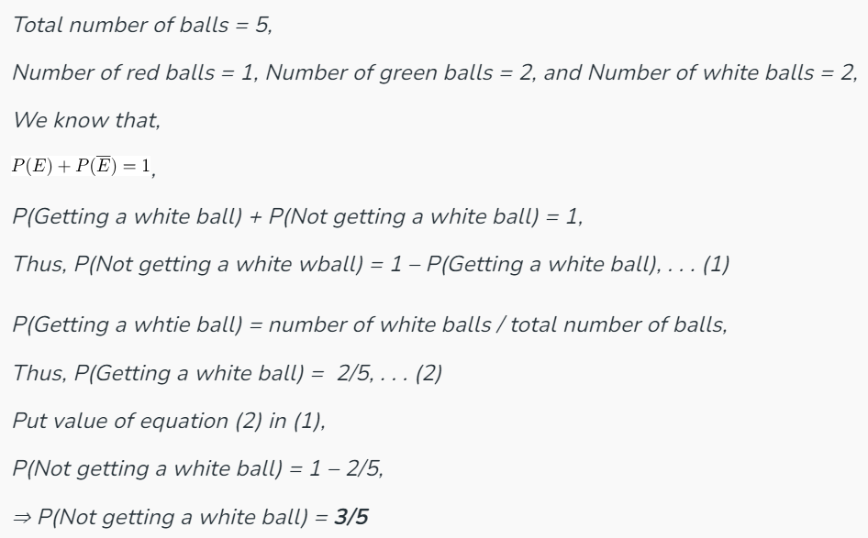
Question
A bag contains 1 red ball, 2 green balls, and 2 white balls. What is the probability of not getting a white ball?

Slide 28
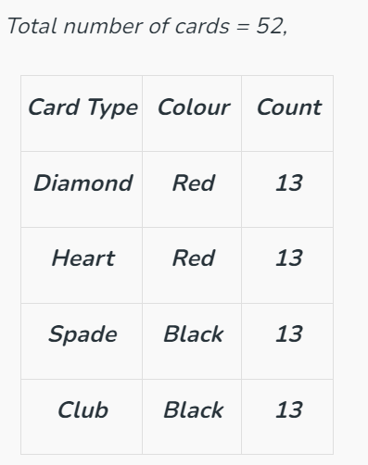
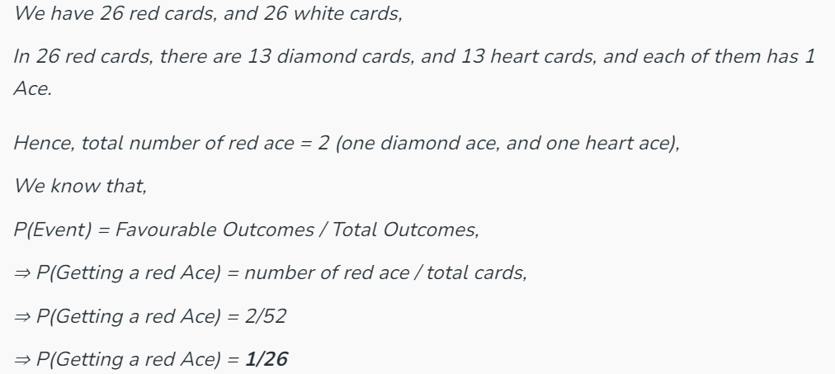
Question - Given a deck of 52 cards. Find the probability of getting a red Ace.

Slide 29
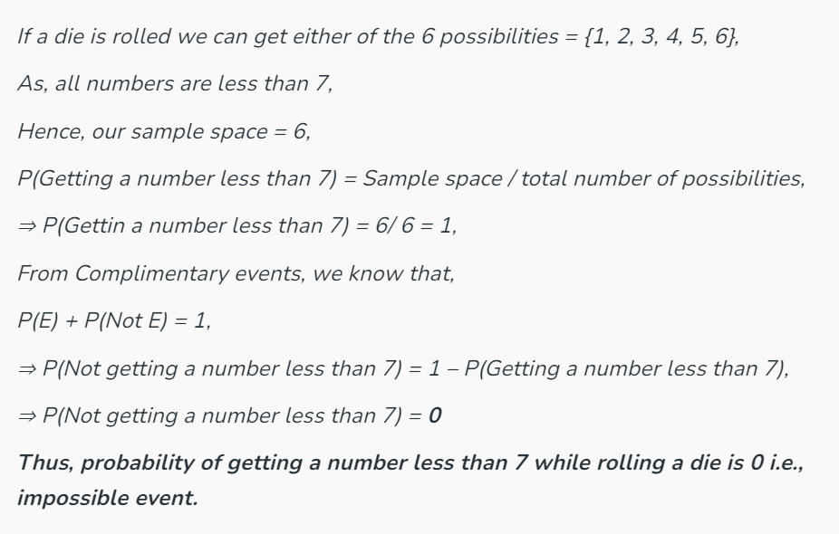
Question - A die is rolled. What is the probability of getting a number less than 7? Also, find the complimentary probability of it.

Slide 30
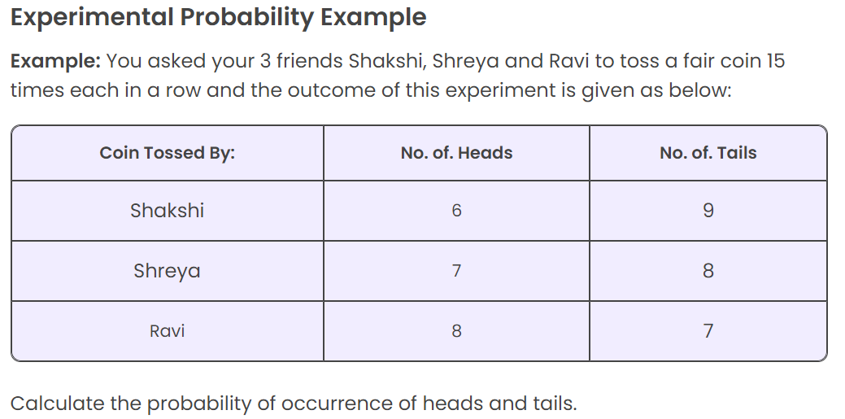

Slide 31
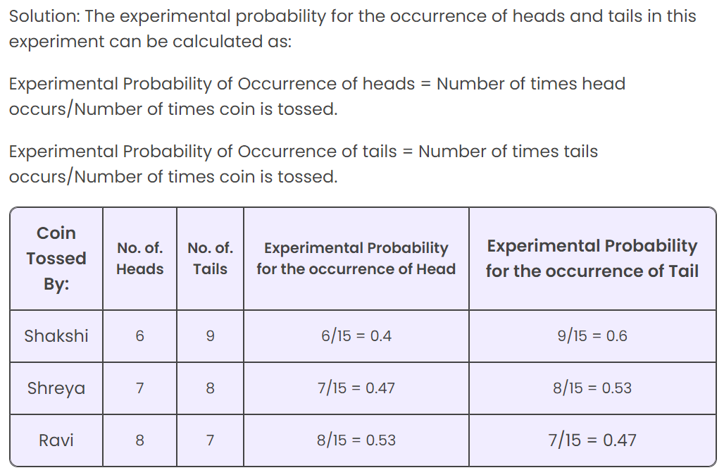

Slide 32
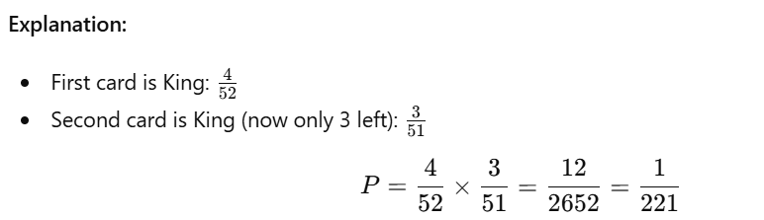
Question:
Two cards are drawn one after another without replacement from a standard deck of 52 cards. What is the probability that both cards are Kings?

Slide 33
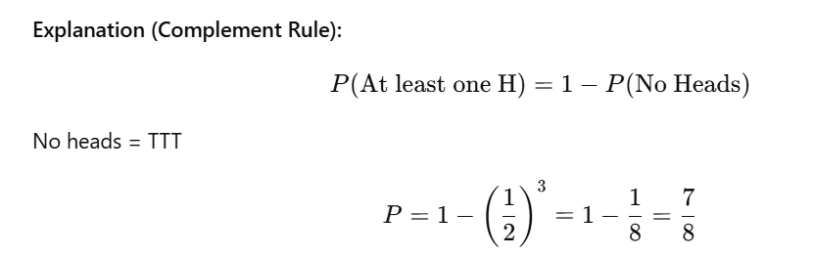
Question:
Three fair coins are tossed. What is the probability of getting at least one Head?

Slide 34
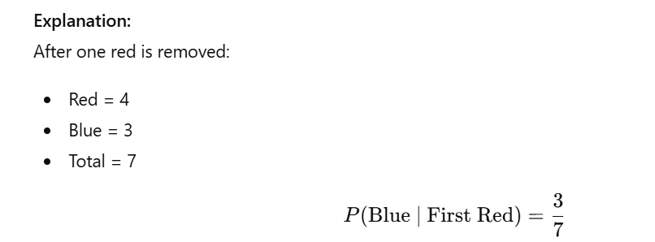
Question:
A bag contains 5 red and 3 blue balls. Two balls are drawn randomly without replacement. Given that the first ball is red, what is the probability that the second ball is blue?

Slide 35
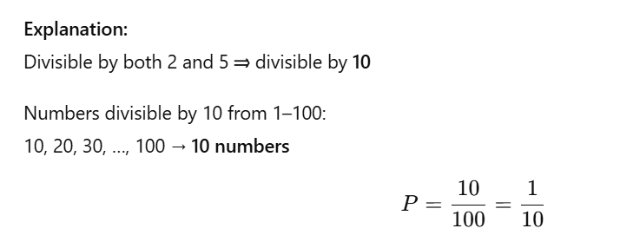
Question
A number is chosen randomly from the integers 1 to 100. What is the probability that the number is divisible by both 2 and 5?

Slide 36
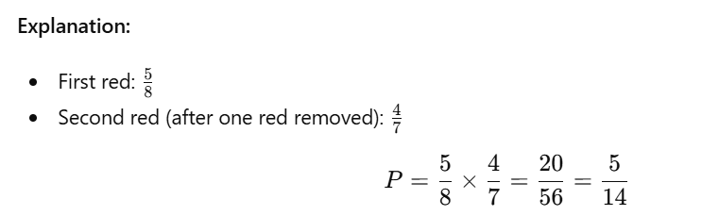
Question:
A box contains 5 red and 3 blue balls. Two balls are drawn one after another without replacement. What is the probability that both are red?

Slide 37
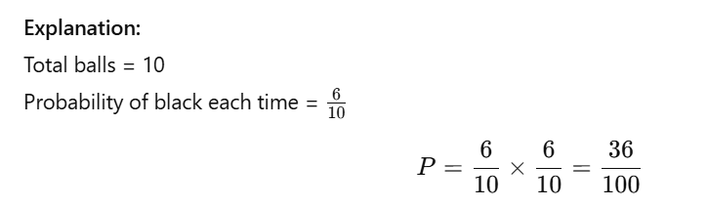
Question:
A bag has 4 white and 6 black balls. Two balls are drawn with replacement. What is the probability that both are black?

